Slide 1
EE 295
TechWriting-Engineering Ethics
Oct 22, 2019
Room E339
Tom Wrappe
EE Lecturer

Slide 2
-Upcoming Writing deliverables
-Midterm Completion
-Final Paper
-Sources
-Outline/Abstract
-Resume Overview
-Product Review: Moriarty
-Materials Ethics-related Case Studies
+Focal Products Discussion
+Other focal products discussion

Slide 3
Fair Warning
In Class Writing Exercise starting at beginning or end of class coming within next two weeks (be on time)
Allowed 25 minutes to complete (hard stop)
Topic will be per recent class lectures and discussions
Up to 10 points with 0 for “no show”
No makeups per syllabus
Attend your own section unless cleared at least 24 hour ahead in writing (deduct otherwise)

Slide 4
Semester Major Items…..(subject to modification)
 | Mid Term | Resume | Final Paper | Final Presentation (slides )
Topic Paragraph | 9.5.19
Topic Proposed | 9.12.19 |  | 10.3.19
Topic Final | 9.19.19 |  | 10.10.19
Outline/ Abstract | 9.26.19 |  | 10.31.19
Research | 10.1.19 | 10.24.19 (Class) | 10.15.19
Draft Complete | 10.13.19 ** |  | 11.7.19 | 11.19.19
Final Submit | 10.25.19 ** | 11.14.19 | 11.26.19 | 12.3.19
Final Presentation | NA | NA | NA | 12.17.19 (Sect 1) 12.12.19 (Sect 2)

Slide 5
Midterm Down the Home Stretch
Step | Due | Notes
Identify topic | 2.14.19 | 1 paragraph on end product (Bring to Class)
Propose a product/ company | 2.21.19 | 600 words overview of the paper (Turnin)
Abstract/Outline | 2.26.19 | Skeleton of the paper
Research Deliverable | 3.5.19 | Supporting Elements
Draft | 3.12.19 | Complete paper, but needing edit
Final Submission | 3.22.19 | Final product

Slide 6
First 5 page Proposal A Concise Version of a Product Proposal
Outline | Outline/ Abstract | Draft (5 pages) | Midterm paper (5 pages) | Final Paper ? 15 pages
1. Abstract | Paragraph | ½ page max | ½ page max
2. Executive Summary | paragraph | ½ to 1 page | ½ to 1 page
3. Product Description | 2 paragraphs or so | 1-3 pages
4 Mkt Research and Analysis | 1-2 paragraphs (5 sources min) | 1-3 pages | Depends on sources
5. Finance and Economics | Short paragraph | ½ to 1 page
6. Management Team | Short paragraph | ½ page
7. Risks and Assumptions | Short paragraph | ½ page
8. Conclusions and Recommendations | Short paragraph | ¼ to ½ page
A. Sources | Not Applicable | ½ to 1 page | ½ to 1 page
The outline endures while the content grows

Slide 7
Midterm: Content Checklist
Item | CHECKLIST ITEM
[a] | Abstract: Motivation Statement
[b] | Abstract: Problem Statement
[c] | Abstract: Results Sentence
[d] | Abstract: Conclusions Statement
[e] | Abstract: Keywords
[f] | Executive Summary: Proposal Background
[g] | Executive Summary: Problem Statement
[h] | Executive Summary: Financial statement related to the proposal
[i] | Executive Summary: Recommended action for “boss”
[j] | Product Description: Product Description (underline all sentences that apply)
[k] | Product Description: Product Differentiators (what is “special” about the proposed product?
[l] | Conclusion: Recommendation Statement

Slide 8
Midterm: Grammar Items Checklist
It | Description | Checklist Item (to be contained in table at end of the paper)
1 | NO PERSONAL PRONOUNS | Confirm no use of “I, we, me, mine, our, ours, let’s, us, you, your, he, she
2 | No use of “Very” | Confirm no instance of “very”
3 | Avoid Passive Voice | Confirm no passive voice
4 | All paragraphs have at least three sentences | Confirm

Slide 9
Autonomous Vehicle Navigation
ABSTRACT— [a] This paper describes a system that navigates the vehicle autonomously. Autonomous vehicle navigation has gained increasing importance in modern transportation systems. [b]In non-urban domains such as deserts, the problem of successful GPS-based navigation appears to be almost solved while navigation in urban domains, particularly in the close vicinity of buildings in dense urban environments, is still a challenging problem. In such situations GPS accuracy significantly drops down due to the impaired GPS signal. [c]This system provides a communication between the vehicle and the internet using a GPRS modem. This navigation system is interfaced with OSRM open source map data through internet. To improve precision of navigation, this system uses location information from inertial sensors to complement basic GPS. The system also uses a rotatable laser range finder for obstacle sensing. This is an internet-connected system that can provide full information to a remote observer. [d]The autonomous vehicle navigation system has broad applications for self driving vehicles due to the higher navigation quality in key urban areas.
[e] KEYWORDS— GPS, GPRS, compass, navigation, localization, inertial, laser

Slide 10
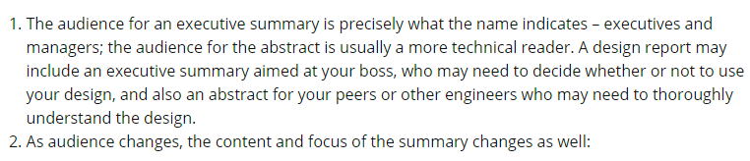
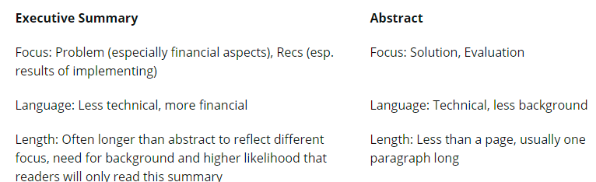
Executive Summary vs Abstract Audience Matters
[g]
[h]
[i]
[c]
[b]

Slide 11
Midterm Paper Checklist (1)
General
Clear title and “numbered” Subsections per the outline
Sources in “ A. Reference Sources”
Proper [xx] citations in the text
Topic Sentences underlined in each paragraph with mostly first sentence in para
Title and Abstract
Descriptive title with correct capitalization. Concise: not too long
Section Title: “1.0 Abstract”
Confirm that [a] Motivation thru [e] Keywords are present
Is the Motivation statement good or maybe needs to be “punched up”
Does [a] Motivation match with [d] Conclusions?
Does [b] Problem statement match with [c] Solution Statement?
“2.0 Executive Summary”
Are [f] through [I] present?
Is [g] problem statement clear?
Is [h] a clear financial statement of value?
Is [i] a clear recommendation?

Slide 12
Midterm Paper Checklist (2)
4. “3.0 Product Description” (Do not use Proposal)
a. Is [j] a clear product description (not a vague technical collection of buzzwords)?
b. Is [k] a clear statement of what makes the product special/differentiated?
5. “8.0 Conclusions and Recommendations”
a. Is there a clear “call to action” to the boss to support this product proposal?
6. “A. Reference Sources”
a. Complete IEEE format for all sources identified in [xx}]

Slide 13
Midterm Paper Checklist (3)
It | Description
1 | Personal Pronouns (I, we, our , us) | Verify by search
2 | No use of “very” | Verify by search
3 | Passives | Search on “is, will be, has been, etc” followed by a verb form (eg. “is developed”). Change to active
4 | Proper Paragraph Structure | Single topic sentence Do all other sentences support the topic sentence? If not, change
5 | Proper Flow | Underline topic sentences Do topic sentences of the paper flow per the outline (Sect 1-8)?

Slide 14
Midterm Draft Feedback
Item | Description of Midterm Draft Issue | Change for Midterm Complete Paper
1 | Did not include checklist of key content and grammar | Include or no grade—late can be 20%
2 | Missing sections compared to standard outline | Include all sections 1.0 through 8.0
3 | Number Subsection Titles (ie 3.0 Product Description) | Suggested in Draft. Required in Midterm Complete
4 | No Bibliography/Sources or Citations in IEEE format [x] | Need both for Complete paper
5 | Paragraph structure test. 1 topic sentence underlined per paragraph. All other sentences support the topic sentence | Should be easy to read paragraph when well structured
6 | Flow Test. Read Topic sentences to get fully flow of paper | Perform before submitting

Slide 15
Final Paper Options

Slide 16
Expanding the Product Proposal for a Final Paper
Outline | Outline/ Abstract | Draft (5 pages) | Midterm paper (5 pages) | Final Paper ? 15 pages
1. Abstract | Paragraph | ½ page max | ½ page max | 1. Abstract
2. Executive Summary | paragraph | ½ to 1 page | ½ to 1 page | 2.Executive Summary
3. Product Description | 2 paragraphs or so | 1-3 pages |  | 3.0 Product Description (ex.) 3.1 System Description (ex) 3.2 Key technologies 3.3 Functional Description (ex.)
4 Mkt Research and Analysis | 1-2 paragraphs (5 sources min) | 1-3 pages | Depends on sources | 4.0 Mkt Rsch 4.1 Market 4.2 Competitors 4.3 Differentiators
5. Finance and Economics | Short paragraph | ½ to 1 page
6. Management Team | Short paragraph | ½ page
7. Risks and Assumptions | Short paragraph | ½ page
8. Conclusions and Recommendations | Short paragraph | ¼ to ½ page |  | 8. Concl/ Rec’s 8.1 Useful features 8.2 Recommended action
A. Sources | Not Applicable | ½ to 1 page | ½ to 1 page

Slide 17
Framework for Research Option #2
Area of Research
The “container” is the Analysis Process you choose:
-Compare multiple technologies by measuring their performance in a consistent “test” process (Comparative Analysis)
-Measure a single technology’s ability to perform a previously unachievable “test” (Feasibility Study)
Specific Topic
(Describe Specific Research
Research is a fluid.
It has the form of the container you choose.
Criteria for Analysis
ANALYSIS
Results and Implications
Conclusions &Recommendations

Slide 18
Final Paper: Research Sources Summary due Oct 15
Submit 20 references related to your topic. Write a paragraph about each related to the info that applies to your topic.
Remember to use IEEE format for citations to identify each source
-Try to get at least 4 different classes of sources: Books, periodicals, journals, online sources, Manufacturer product info, ….
-Consider using figures, drawings, etc from the sources if that is useful (remember, they get cited differently than other sources)
-Use a consistent, concise approach:
a. Source in IEEE format based on author’s center
b. Full sentences identifying the contribution of the document to your paper based on your study of the item
Put “Bibliography” or “References” near the top of your paper to avoid high plagiarism score

Slide 19
Example Final Research
Title (of your paper)
Bibliography
[1] Source #1: (source in IEEE format)
This source describes the market for self-driving automobiles and predicts a size of XX units in 2021 growing to YY by 2026
[2] Source #2: (source in IEEE format)
This proceeding from an IEEE forum meeting examines alternative navigation systems and predicts a hybrid of GPS, cellular tower and barometric pressure will be suitable for self-driving cars in 2022. In addition, AI methods are expected to be applied for the hybrid navigation algorithms
[3] Xxx
[4] Yyy

Slide 20
Final Research Items
Item | Description | Resolution
1 | Not enough sources | 20 minimum sources
2 | Not full IEEE format for citations | Review especially online sources (include Access time/day)
3 | Too high TII score | Relook format and make sure Sources positioned below key word describing “ Sources to follow”
4 | No sentences for content | Write sentence or two
5 | No diversity of sources (Books, periodicals, online, conference proceedings, dissertations) | Get additional sources
6 | Figures | Proper citations

Slide 21
Final Paper: Outline/Abstract due Oct 31
Submit an outline and an abstract For your final Paper using 1-2 pages
Expand on your topic selection
-”Fine tune” your topic
-Create outline based on the complete Product Proposal or Research Paper outline
-Prepare a summary with one or two paragraphs (not bullet items, full sentence-based paragraphs) that capture the key elements of each section
Summarize your market and technology research (previously 20 sources)
-Fill out a complete checklist per instructions as a condition of grading
3.Provide a “budget” totaling 7200 +/- words (15 pages) for your Final Paper (Extended Proposal) or 5600-6000 words (10 pager Research)
4.Be ready to discuss during Nov 5 and/or Nov 7 class
5. Checklist and Peer Review (2) within one week of deadline
6.As always, 15% plagiarism or less is required from Turnitin

Slide 22
Resume Preview

Slide 23
Start the Resume Research
-Posted on Canvas
-Final Due Nov 14, 2019
-BRING AT LEAST ONE JOB POSTING TO CLASS TU, Oct 29 and/or TH, Oct 31
-Find three (3) job postings. Analyze them, and determine what will influence the company to select you for consideration.
Write an analysis paragraph for each indicating how you think they will make the decision, what you have to offer, what you hope to get, and what the company will offer, and what they hope to get.
Indicate what you will place in the resume to influence the decision maker. Look beyond just the technical.
Write a targeted resume for each company.
Submit analysis and resumes on Canvas. The analysis must be plagiarism checked. Please put analysis and resumes in separate files. The resumes will be checked, but not scored.

Slide 24
Key Elements of Job Descriptions
Job Overview
Area
Responsibilities
Qualifications
Minimum
Preferred
Experience
Special Opportunities/ “Wild Cards”

Slide 25
Resume OOC Exercise
Analyze the job description and determine what will influence the company to select you for consideration
Write an analysis of each job indicating how you think the company will make the decision to interview and hire
what you have to offer, and what you hope to get
what the company will offer, and what they hope to get.
Indicate what you will place in the resume to influence the decision maker.
Look beyond just the technical

Slide 26
The OOC Work Product
Provide a summary of what you are going to do and the elements that you are going to provide for each of the three job descriptions
Answer all the questions that are laid out in the assignment in a consistent, readable way
Finish up with a short conclusion on each analysis
Attach the resumes as a followon to the analysis
High Level Outline for OOC Assignment
Summary of assignment and your approach to analysis
Analysis #1
Analysis #2
Analysis #3
Resume #1, 2, 3

Slide 27
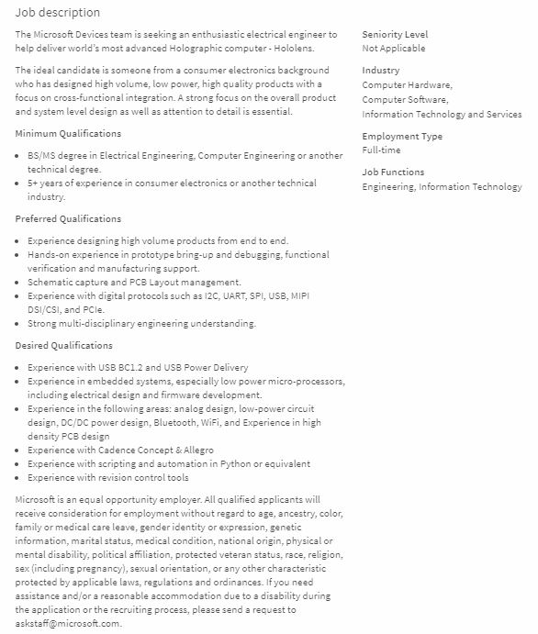


Slide 28
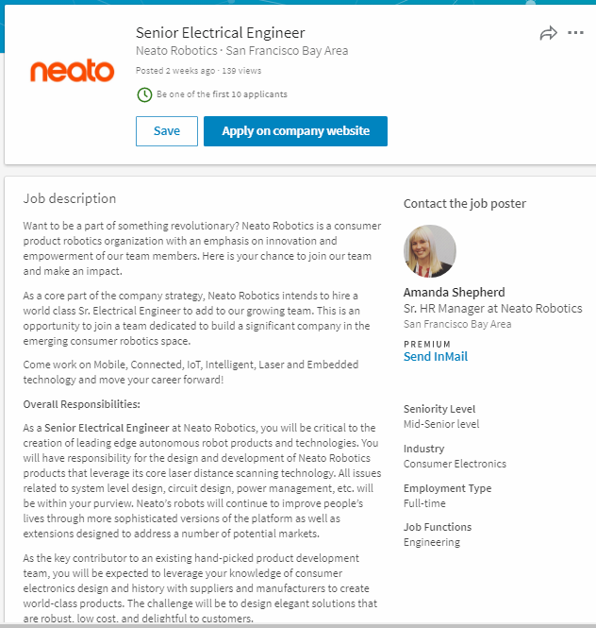

Slide 29
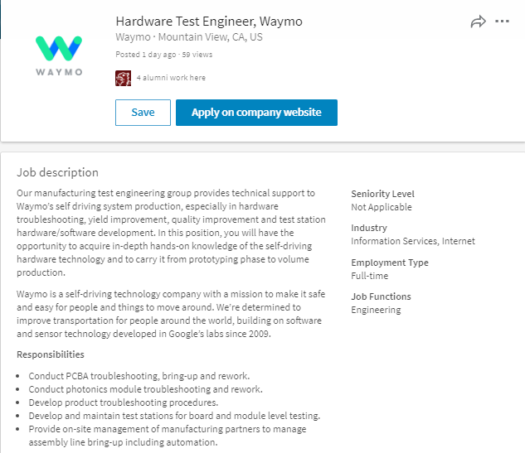

Slide 30
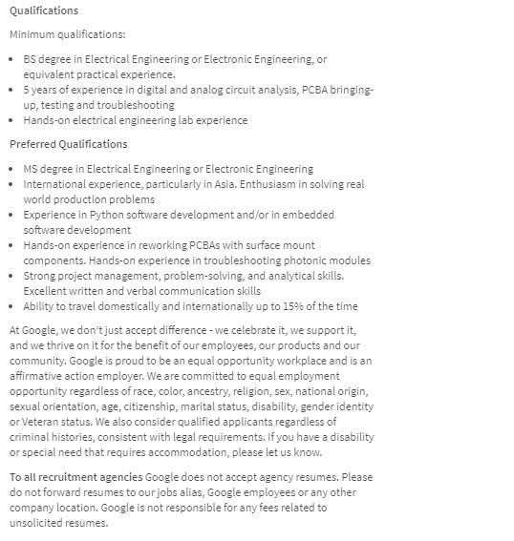

Slide 31
Material Ethics
Material Ethics
Eugene Moriarity, (2008) “Material Ethics, Chapter 8” in The Engineering Project, Its Nature, Ethics and Promise, Penn State Press
Tom Wrappe
EE Lecturer

Slide 32
Material Ethics

Slide 33
In Class Discussion to Be Continued This Week
Focal Products
Research Examples of Focal Products
Candidates will be discussed in class and put forth in class discussion

Slide 34
Agenda
Focal Engineering is Local
Consequentialism
Assessing the Product
Consensus Conference Model
Conclusions

Slide 35
Material Ethics
Material Ethics seeks to measure the “Focal-ness” of products
Based on work by Albert Borgmann
Key factors include engagement, enlivenment, and resonance
Focal Products are not same as Human Factors Engineered products
Human factored products are designed to adapt to human users
Human Computer Interface (HCI) is an emerging field of work
Human factor engineering necessary but insufficient for Focal product
Human factors combine physical and psychological to enable absorption of product (intuitive to use)
Focal Products seek engagement with users and harmony/resonance with the life world, a more complete product
Material Ethics goes beyond the Virtue Ethics and Conceptual Ethics of the professional engineer
More complete, public policy view
Requires more than just engineer involvement to achieve focalness

Slide 36
Focal Engineering is Local
Material Ethics
“Think Globally, Act Locally”
Focal Engineering can address Local Issues, providing Global impact
To be focal, product must be good, do good, or contribute to the good in the local context
Project of focal engineering seeks to impact the world, the ecology
Engaging, Enlivening and Resonant
Based on deployment of a system, device, organism or structure

Slide 37
Consequentialism
Material Ethics
Material Ethics is a form of Consequentialism
Moral right of an act depends on its outcome
Consequence of focal product is more harmony in the life-world
Material Ethics is not utilitarianism
Utilitarianism is a form of Consequentialism
Utilitarianism seeks most good for most number
Grand by its nature
Material Ethics is more to the day-to-day end of the Consequentialism spectrum
More intuitive end of morality
More concerned with “the concrete dailiness that channels our endeavors and aspirations”

Slide 38
Assessing the Product
Material Ethics
How well does the interaction of product, end use and lifeworld realize the values of Material Ethics
Engagement
Enlivenment
Resonance

Slide 39
Material Ethics Seeks to Assess “Focalness” of an Endeavor
User
Engagement
Enlivenment
Product
World
Resonance

Slide 40
Consensus Conference Model
Material Ethics
Conversation with the Life-World is the ultimate authority regarding “focalness”
Gathering, Discussing and Voting are necessary but not sufficient
Consensus Conference Method
Lay panel and expert panel
Lay panel makes decision informed by expert panel
Both should have focal engineer representation according to Moriarity
Danish Board of Technology is a real world example-Quasi government body

Slide 41
Consensus Conference
-Lay Panel takes the lead and appoints the expert panel
+Assess Virtue Ethics of expert panel
+Material ethics score as weighted average of engagement, enlivement and resonance
-Seek a true consensus that becomes policy

Slide 42
Conclusions
Material Ethics
Reflection and Assessment should precede “unleashing a new technology on the planet”
Discussion of the AIMS of the project brings modern engineers face-to-face with Focal engineering
Focal engineering acts locally to foster engagement, enightenment, and resonance
“Best Practices” for Focal Engineering may be to keep disengaging products away
Material Ethics assessment is based on relating engagement, enlightenment, and resonance to the product/user/world
Informed consensus approach key to achieving Material Ethics since it provides necessary inclusion

Slide 43
10 Technologies That Deserve to Die?
1. Nuclear Weapons
2. Coal- Based Power
3. The Internal Combustion Engine
4. Incandescent Light Bulbs
5. Land Mines
6. Manned Spacecraft
7. Prisons
8. Cosmetic Implants
9. Lie Detectors
10. DVDs
Define the Technologies
Ethically, do They Deserve to Die? How would you score the Materials Ethics of the identified technology?

Slide 44
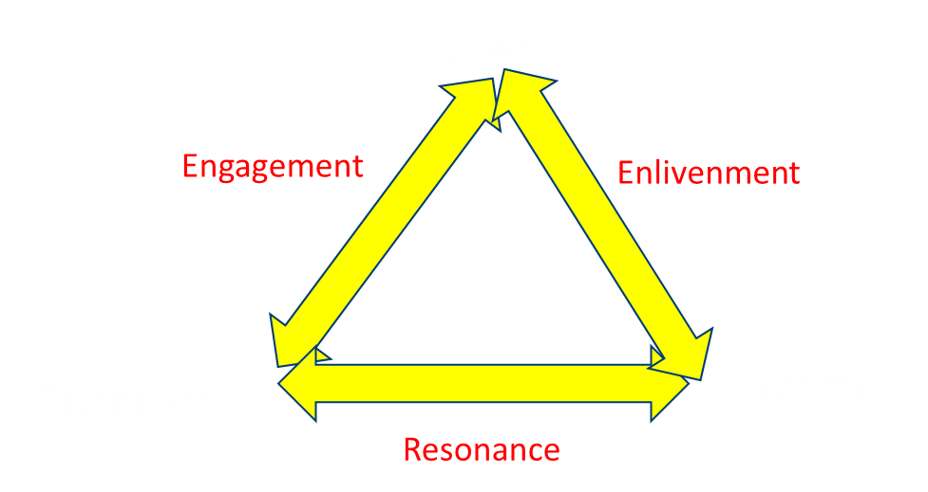
Assessing (New) Coal-Based Power
Engagement: End User and Product interaction→ (+3 to -3)
Enlivenment: End User and World (based on use of product)→ (+3 to -3)
Resonance: Product and World Interaction→ (+3 to -3)
Jm= a1(Jeg) +a2(Jen) +a3(Jre), where a1+a2+a3=1.0

Slide 45
Conclusions
Balance
Three kinds of ethics for three types of engineers
Premodern engineer > Virtue Ethics : Objectivity, Honesty and Caring
Modern engineer> Process Ethics
Focal Engineer > Material Ethics guides products
Premodern Engineering
Engineering endeavor, Engineer, Engineered bound up and contextualized
Think of the major cathedrals
Modern Engineering
Shift to colonization where function rules and hypermodernism arises
Consider Semiconductors and the derivative product proliferation
Focal Engineering
Balance Contextualism and Colonization
Seek the Good resulting in products that enliven, engage and resonate

Slide 46
Three Types of Ethics
VIRTUE ETHICS--Person
Objectivity/Honesty/Care
CONCEPTUAL ETHICS—Profession
Social Justice/Environmental Sustainability/Health & Safety
MATERIAL ETHICS—Focal Product
Engagement/Enlivenment/Resonance

Slide 47

MATERIAL ETHICS/ Focalness of Product
PRODUCT
RESONANCE
ENGAGEMENT
ENLIVENMENT
END-USER
WORLD

